Slide 1
Jadcup Digital Twin Mid-Term Project Review
Joshua Ladowsky – Service Request Manager/Project Leader
Myles Hosken – Service Delivery Manager/Developer
Yeran Edmonds - Developer
Harshil Patel - Developer
Jane Jung - Developer

Slide 2
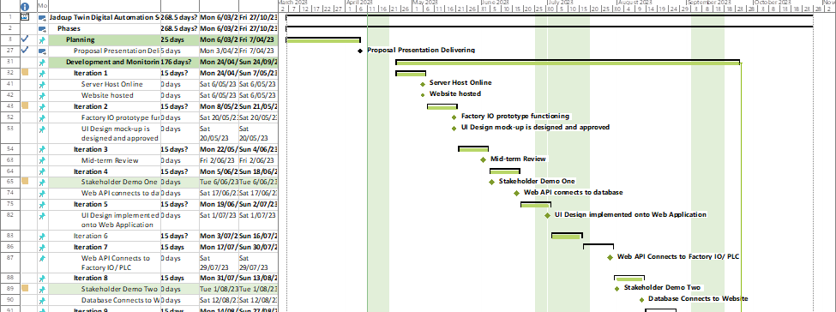
Addressing proposal feedback
Milestones/Project Schedule
Additional milestones were created
Project Schedule revised and updated to include milestones

Slide 3
Addressing proposal feedback
Addressing Risks
Risk management – Will add a section to discuss potential improvement/strategies going forward to iteration reviews. Team schedule (Extra meeting Fridays 2-4pm Sem 2).

Slide 4
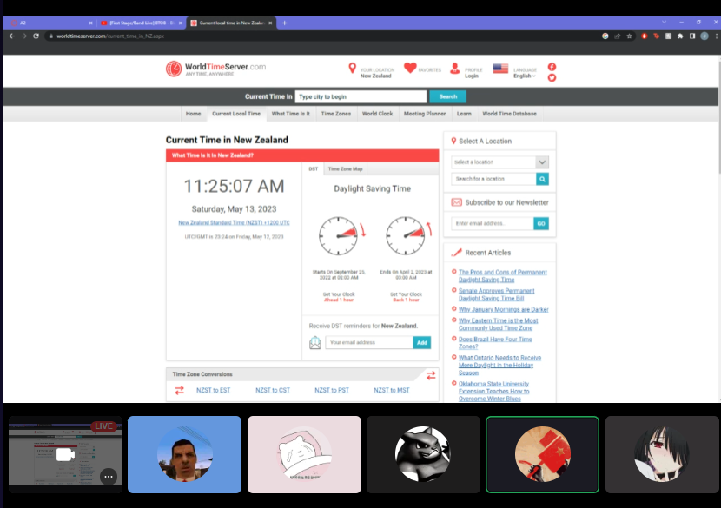
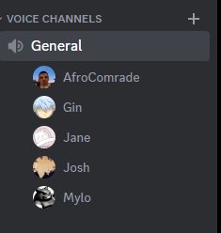
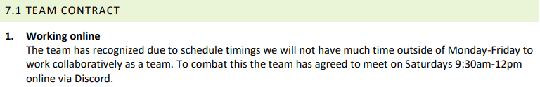
Addressing proposal feedback
Team Contract:
Formalised the Saturday meeting

Slide 5
Addressing proposal feedback
Development:
The code only affects necessary systems.
Developers have reasonable expectations that the code will pass testing and review.
Code achieves user story.
Testing:
The code passes unit tests.
The code passes integration tests.
Test matrix filled and attached to card.
Matrix added to metric record.
Review:
Code fulfills programming standards.
The code is well documented.
Testing done is relevant and effective.
Evaluation report written and attached to card.
Quality Management:
Definition of done
Outline of the expected outcomes of a user story for a given stage
Definition of ready
The requirements that must be met for a card to be started

Slide 6
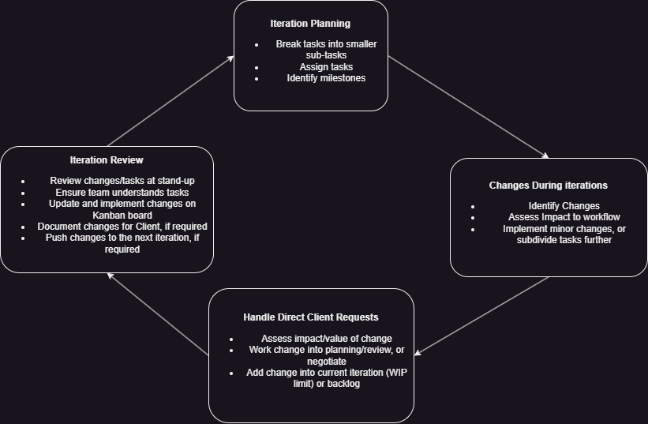
Addressing proposal feedback
Change Management
Change Management reworked into methodology.
Change forms removed.
Change Management Identified as a risk.

Slide 7
Upskilling
Name | Key Skills
Yeran Edmonds | Factory IO JS Modbus
Myles Hosken | Firebase – Realtime Database - Server Hosting
Jane Jung | UI Design React
Harshil Patel | UI Design React
Joshua Ladowsky | Factory IO UI Design

Slide 8
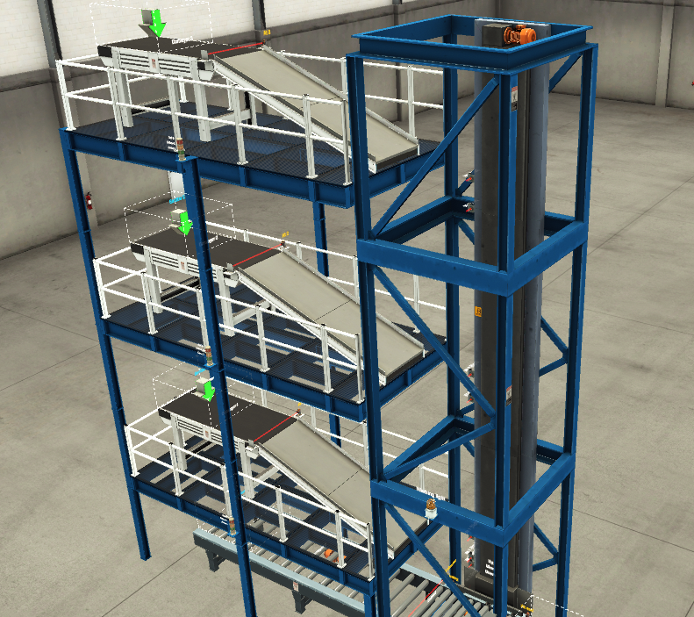
Current Project status
Milestones Reached:
Server hosted ✅ Website hosted ✅ Factory IO Prototype ✅
Project Review
Milestone Delay - UI Design
Iteration Reviews - Definition of Done - Weekly Planning
- Process Reviews
Project Demo
Iteration 4 - Web API
- Stakeholder Demo
Portfolio Q&A
index.html

